Slide 1
Boeing Business and Financial Overview

Slide 2
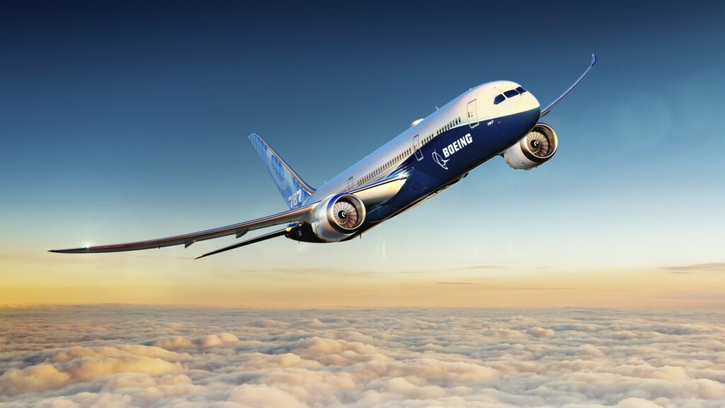
AGENDA
Company Overview
General Business Strategy
5C’s Analysis
Financial Trend Analysis
4P’s Analysis
Issues
Recommendations

Slide 3
ABOUT BOEING :
Founded : In 1916 by William E. Boeing as Pacific Aero Products Company, focusing on building aircraft and military technology
1997 Merger with McDonnell Douglas: The merger created one of the largest aerospace companies, expanding Boeing's product portfolio and market reach in commercial and defense sectors
Advanced R&D: in aviation, sustainable aviation fuel (SAF), autonomous flight, and space exploration
Sustainable Advancement: Boeing is working towards carbon-neutral growth by 2050, through innovation in aircraft technology and green aviation solutions.
Backbone of U.S. Aviation
America’s Aerospace Giant
Cornerstone of American Industry
A National Champion
A Critical Defense Contractor
One of America’s Largest Exporters

Slide 4
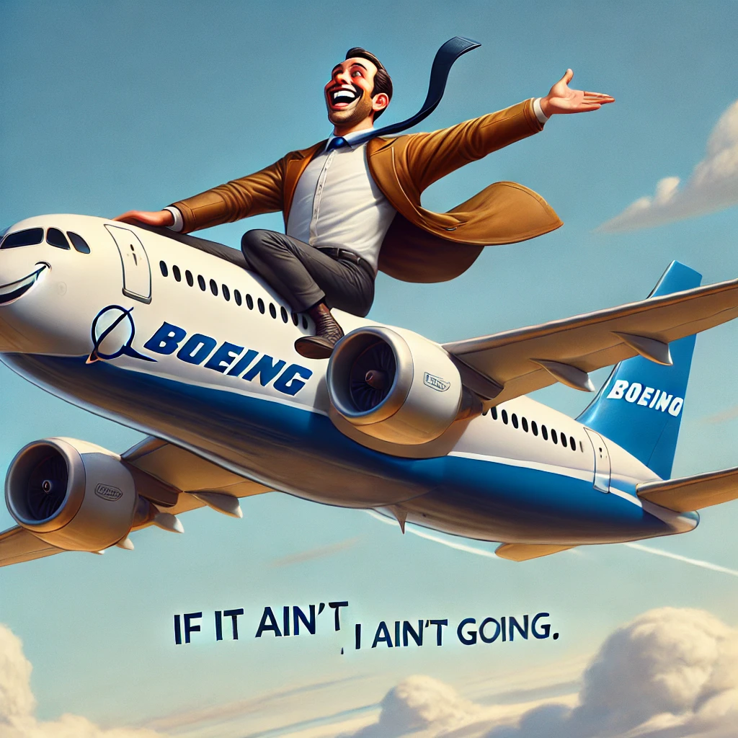
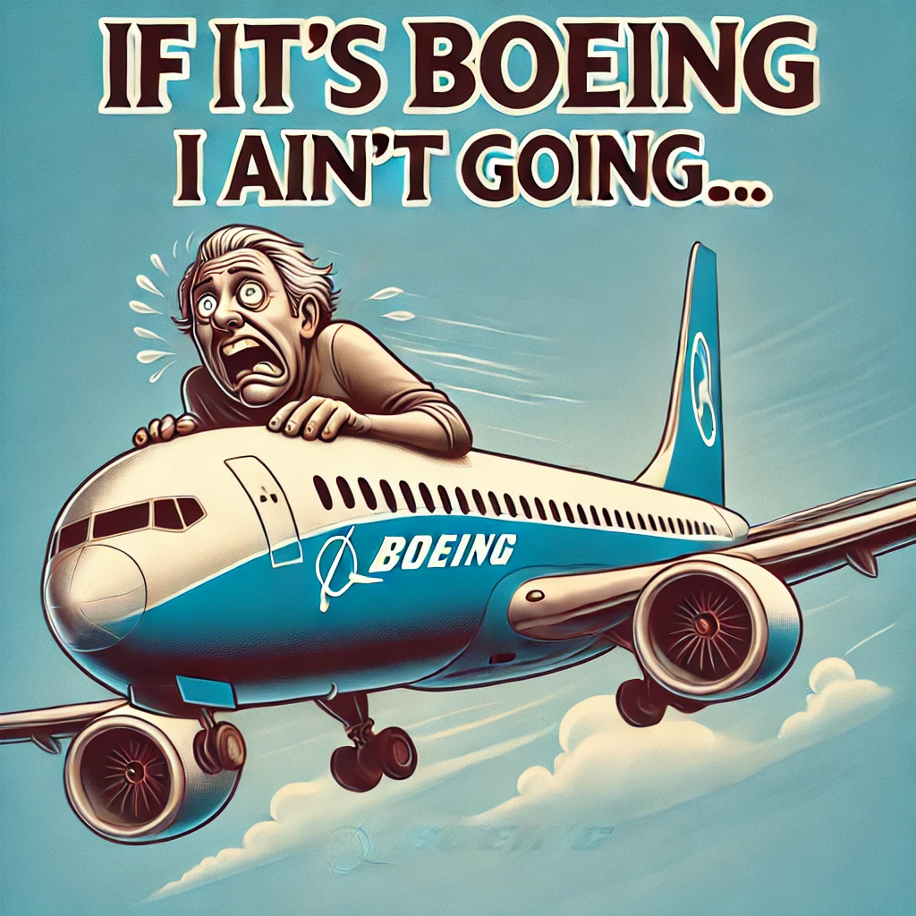
GENERAL BUSINESS STRATEGY
Diverse Revenue Streams:
Boeing generates revenue through a mix of commercial aircraft sales, defense and security products, and aftermarket services. This diversification enhances financial stability and resilience
Customer-Centric Approach:
Foster strong relationships with airlines and customers by providing tailored solutions and comprehensive support services.
Global Market Expansion: Increase presence in emerging markets, particularly in Asia-Pacific, to capture growing air travel demand.
Defense and Space Growth: Continue to invest in and grow Boeing’s defense and space divisions, seeking contracts and partnerships in these sectors

Slide 5
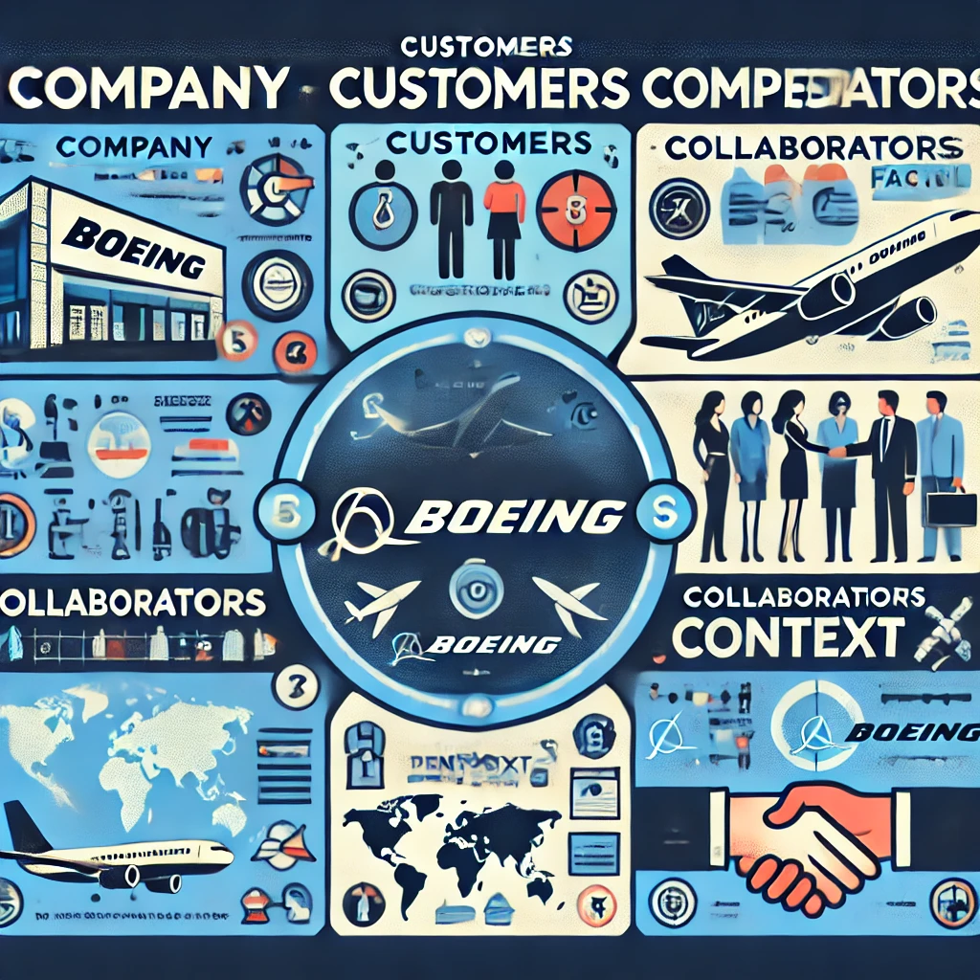
5C Analysis
5C Analysis

Slide 6





5Cs Analysis
Internal
External
Company
Customers
Competitors
Collaborators
Context
Over the past 15 years, Boeing has maintained a dominant position in the twin-aisle delivering nearly 2,600 jets, compared to just over 1,800 by Airbus
Holds 70% of the current backlog for new twin-aisle jets
Customer demographics include commercial airlines, government agencies, defense contractors
Boeing also collaborates with NASA and commercial space operators for space exploration
Ideal customers for Boeing are airlines that have long-standing relationships with the company and a high degree of fleet commonality
Boeing’s primary competitor, Airbus, offers a diverse range of commercial aircraft, including the A320 and A350 families
Chinese Manufacturers: Companies like COMAC (Commercial Aircraft Corporation of China) are emerging competitors in the commercial aircraft market, aiming to capture a share of the market with models like the C919
Boeing collaborates with a global network of suppliers for essential aircraft components, including engines, avionics, and other critical systems
It’s reliance on outsourcing has led to significant production and quality control challenges, particularly during the 737 MAX crisis and the pandemic
Recently announced acquisition of Spirit AeroSystems
Political scrutiny and regulatory issues have intensified after recent safety incidents, such as the door plug failure in the 737 MAX
Ongoing investigations present legal challenges that add to the complexity of Boeing's recovery efforts
With Airbus holding 62% of the market share, few airlines are willing to pay switching cost to move to airbus

Slide 7
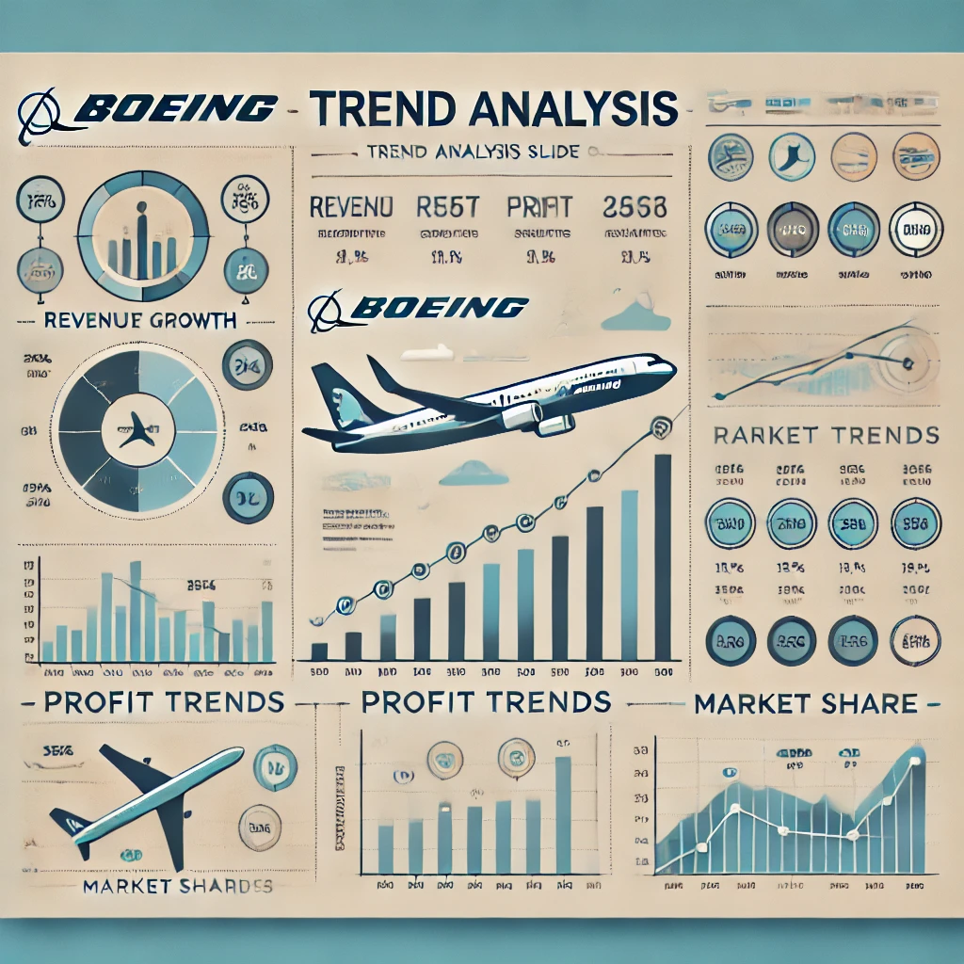
TREND ANALYSIS

Slide 8
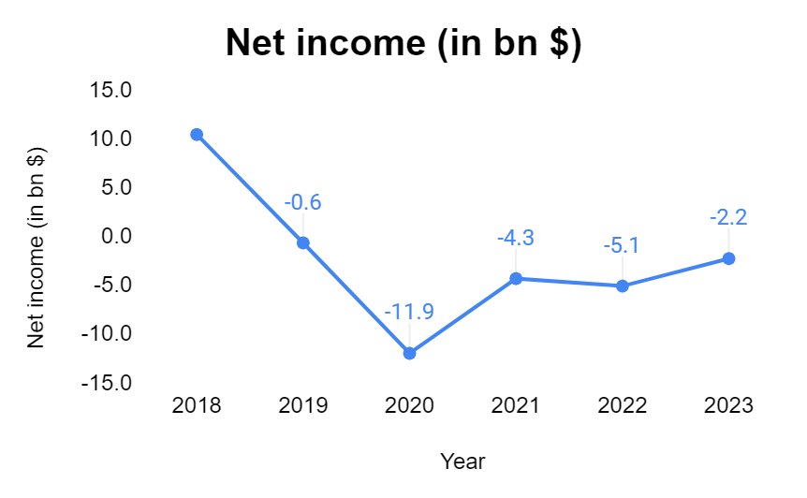
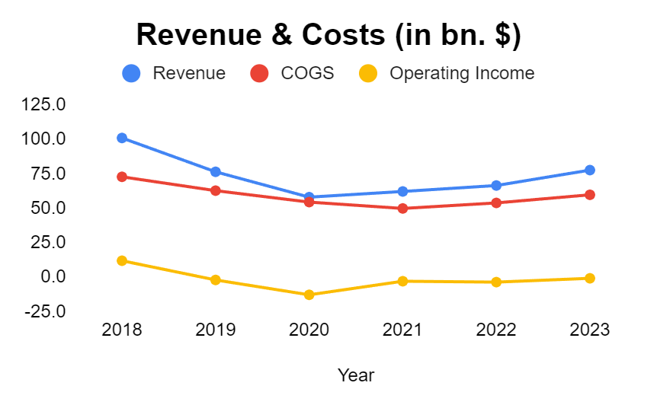
Net income fell from $10B in 2018 to a $5B loss in 2020, recovering to a $2B loss by 2023.
737 Max grounding in 2019 and the pandemic slowed demand, causing a sharp revenue decline.
Global supply chain disruptions increased production and raw material costs during the pandemic
Income began recovering post FAA 737 Max approval in late 2020 but remained below pre-grounding levels.
Net income dropped by 150% from $10B in 2018 to a $5B loss in 2020, then recovered by 60% to a $2B loss by 2023

Slide 9
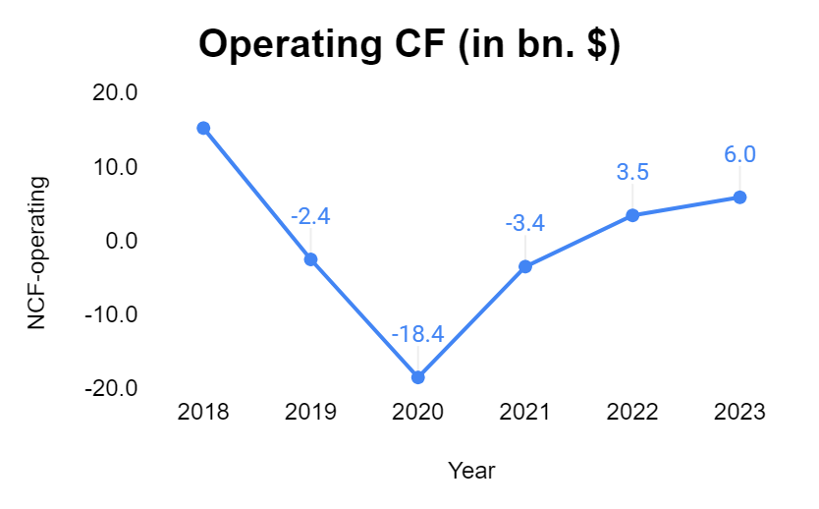
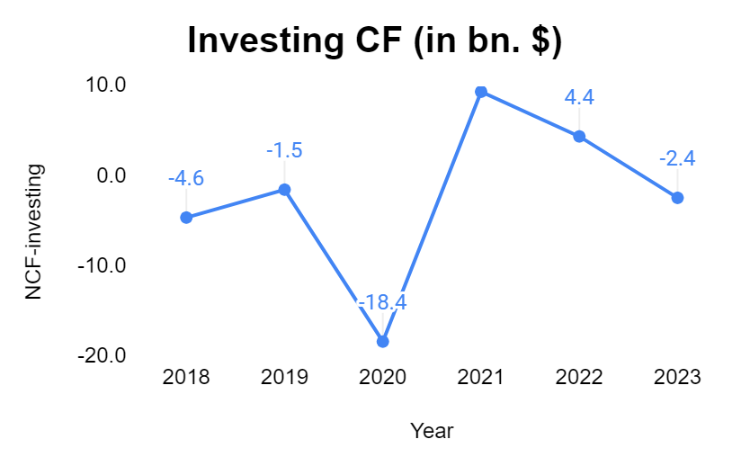
Operating cash flow fell by 220%, while investments rose by 350% between 2018 and 2020
Operating cash flow dropped from $15B in 2018 to -$18B in 2020, Investments rose from $4B to $18B during the same period.
Grounding of the 737 Max and pandemic led to deliveries getting deferred, which heavily impacted Boeing’s cash flow.
Invested heavily ($18B) in safety fixes, software upgrades, and necessary certifications to bring the aircraft back to service.

Slide 10
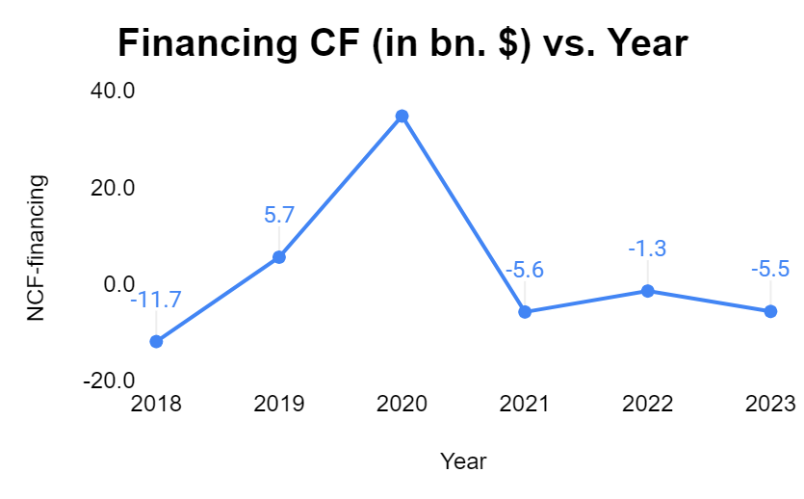
How Did Boeing Fund Its Cash Needs?
Boeing took on $36B in new debt and began repaying it in subsequent years.
How was this funded?
Corporate Bond Issuance:
$25B of Boeing’s debt in 2020 came from corporate bonds. The bond sale was heavily oversubscribed, signaling investor confidence in Boeing's long-term future despite challenges.
Federal Reserve Interest Rate Cut:
The Federal Reserve cut interest rates to near zero in response to the pandemic. Boeing took advantage of these low rates to offset immediate cash flow needs.

Slide 11
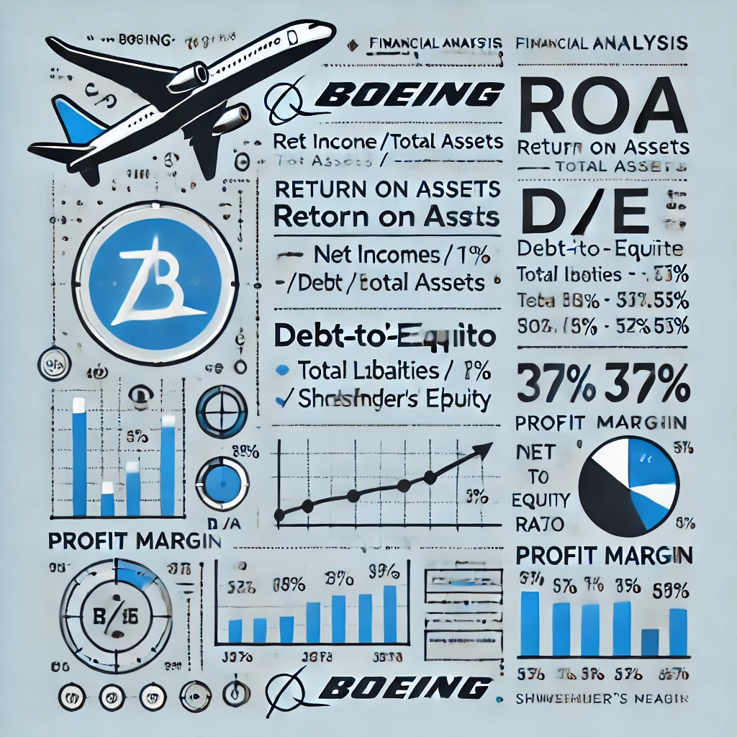
Financial Ratios

Slide 12
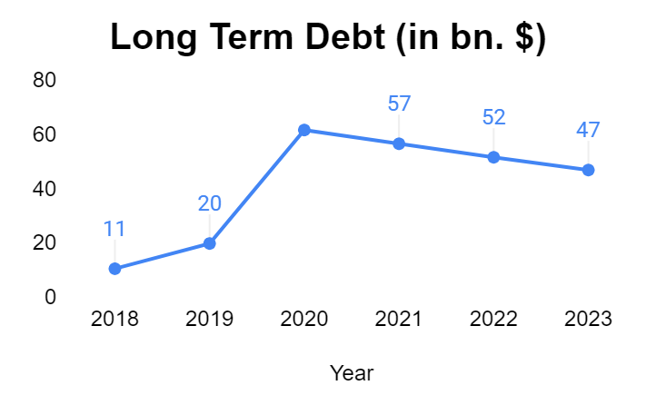
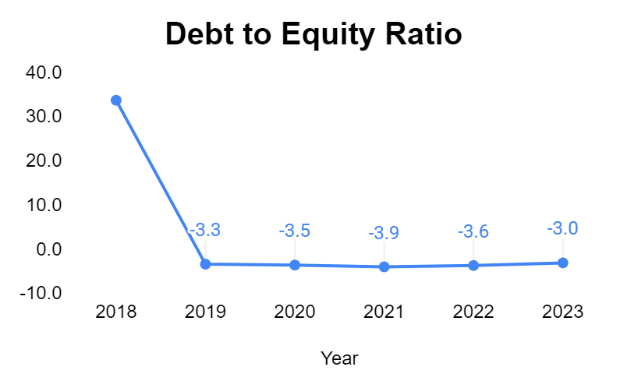
Debt-to-Equity of -3.0 indicates a highly leveraged financial position
In 2020, Boeing issued significant corporate bonds to raise debt and fund operations, increasing its long-term debt.
Currently, Boeing is using its free cash flows to pay off portions of its debt, aiming to restore financial health.

Slide 13
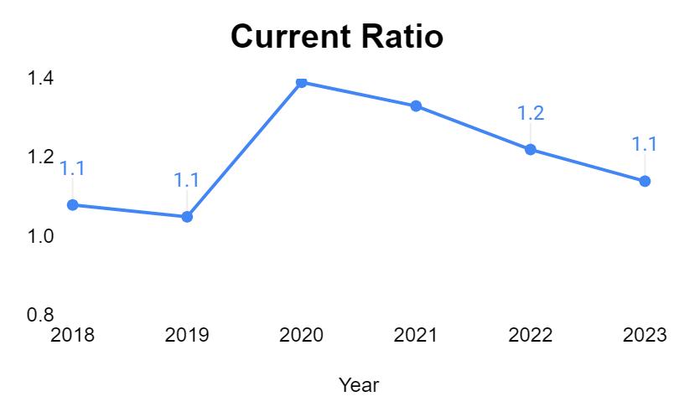
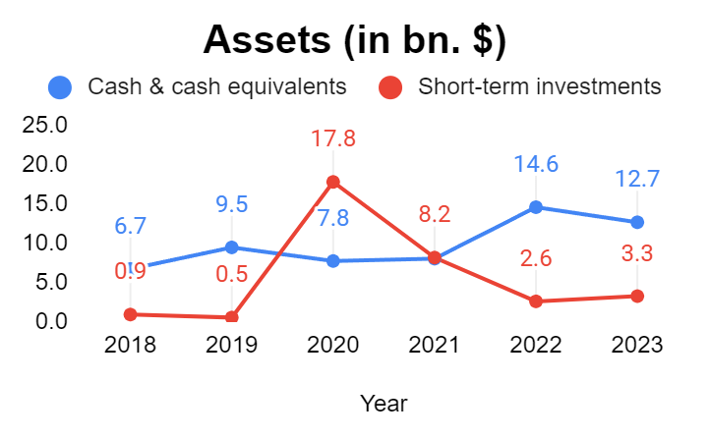
Boeing's current ratio rose to 1.4 in 2020 due to debt, then fell to 1.0 as they started repaying from 2021.
Boeing sold more than $10 billion in short-term investments, which primarily included U.S. government securities, and corporate bonds to liquidate funds.
Boeing's current ratio declined due to the 737 Max grounding and the pandemic, signaling potential difficulty in covering immediate liabilities.
To address this, Boeing raised debt to improve its current ratio and cover short-term obligations.
Post-2020, the current ratio decreased further as Boeing prioritized using free cash flows to pay down long-term debt.

Slide 14
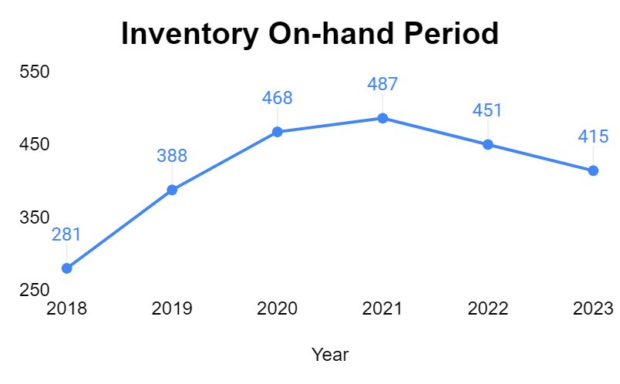
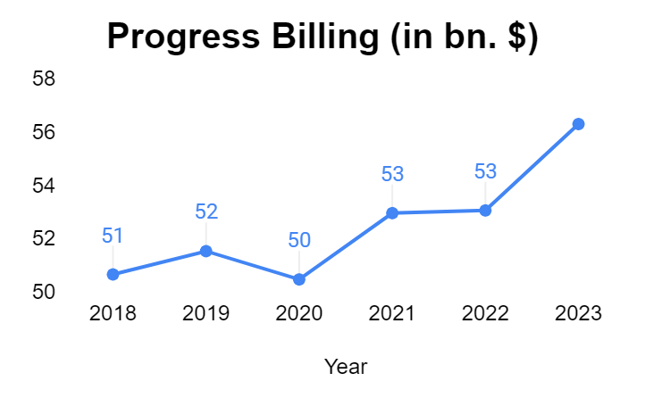
Boeing's inventory on hand period stands at 415 days
Inventory on Hand Period
Boeing needs 415 days to sell its inventory.
Significant delays due to Quality Control issues.
Extended inventory period highlights production challenges
Progress Billings
Invoices submitted at different stages of a major project for completed work.
Common in long-term projects like aircraft production.
Frequent progress billings reflect Boeing's large backlog and efforts to improve production efficiency

Slide 15
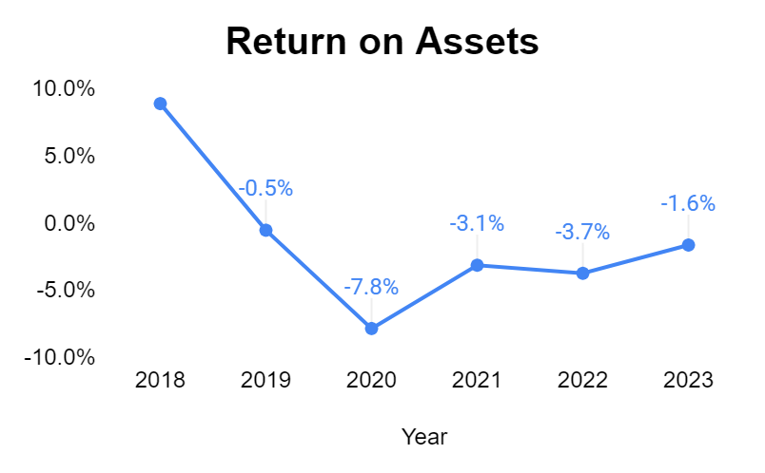
Return Of Assets -1.64% reflects their inability to generate profit from its assets
A negative ROA highlights challenges like high operating costs, reduced revenues, or inefficient asset utilization.
This aligns with the financial strain Boeing faced due to the 737 Max grounding and the lasting impacts of the COVID-19 pandemic.

Slide 16
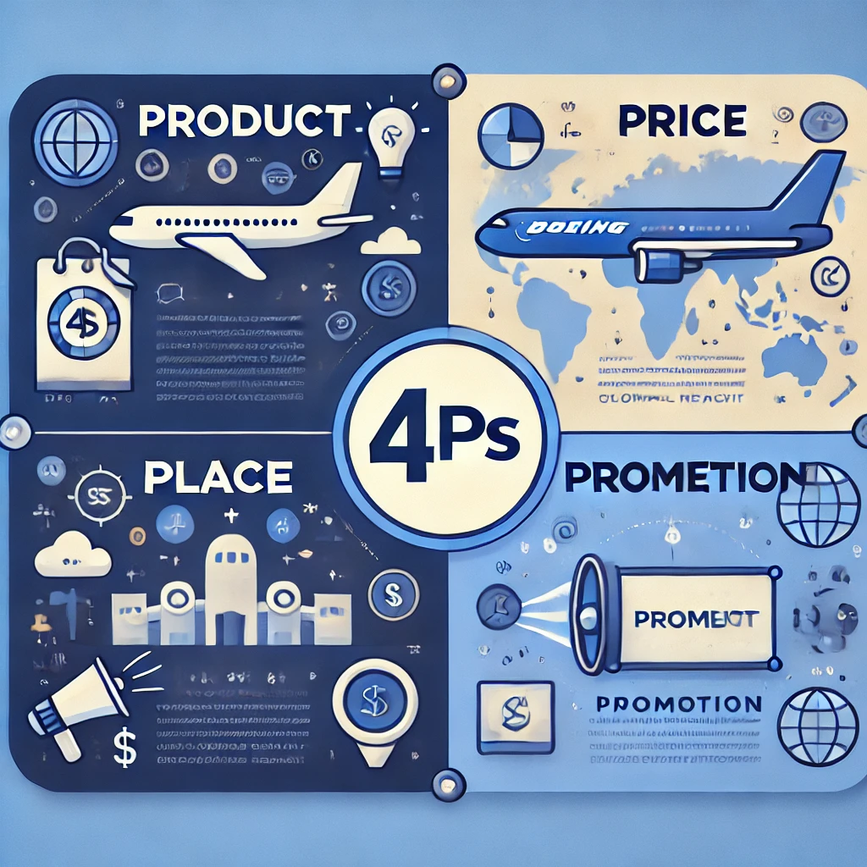
4Ps of Marketing Mix

Slide 17
4P’s of Marketing Mix
Product Strategy
Boeing offers a wide range of products:
Commercial Airplanes - e.g., 737, 777, 787 Dreamliner
Military Aircraft - e.g., F/A-18, AH-64 Apache
Space Systems - e.g., NASA’s Space Launch System
Satellites, Autonomous Systems, and other defense technologies
Price Strategy
Boeing and Airbus operate in a duopoly, leading to mostly premium pricing
Competitive pricing for similar products, with high discounts offered to compete with Airbus
Price discrimination based on carrier size, order volume, and specific product situations (e.g., 737 Max grounding)

Slide 18
4P’s of Marketing Mix
Place Strategy
Global Manufacturing:
Major plants in the U.S. (e.g., Everett, WA; Charleston, SC)
Facilities specialize in specific products like 737, 777, and 787 models
Sales & Service Hubs : Worldwide (North America, Europe, Middle East, Asia-Pacific)
Diversified Distribution Channels: Commercial airlines, government contracts, private corporations
Promotion Strategy
TV Commercials & Print Media: Showcases innovations like the 787 Dreamliner
Event Sponsorships (e.g., Paris Air Show, Dubai Airshow)
Direct Marketing: B2B focus with airlines and governments
Indirect Marketing: Targets consumers by promoting comfort and eco-friendliness of Boeing aircraft, influencing airline purchases

Slide 19
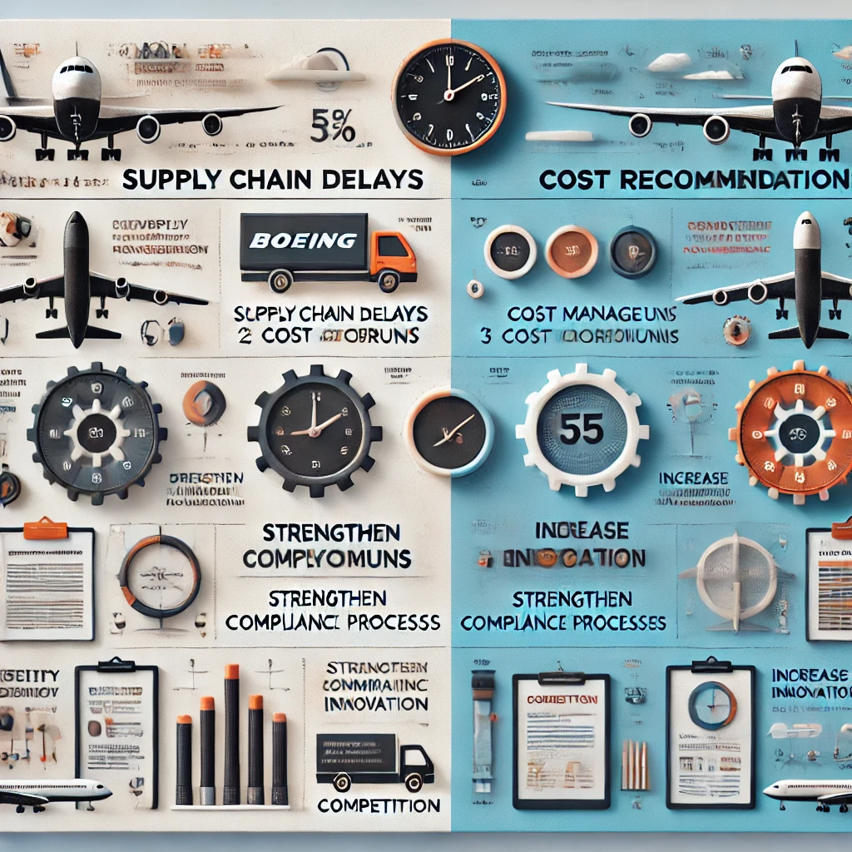
Issues & Recommendations

Slide 20
Issues currently plaguing Boeing
Quality Control Issues :
Budget overruns and delays :
The two crashes, as well as the blow-up of a door of Alaska Airlines, led to a significant decline in faith in Boeing and its capabilities.
Supplier oversight failures and lapses in internal inspections, such as metal contamination in aircraft, further underscored weaknesses in Boeing's safety culture.
These issues, often driven by cost-cutting and production speed pressures, have prompted the company to reform its processes and safety standards
The new program for the 777-X aircraft has faced significant delays from 2020 to 2026 and beyond, costing the company billions of dollars.
The development of the 787 Dreamliner, for instance, experienced severe delays and cost overruns, largely caused by reliance on an extensive global supply chain and the need to rework faulty components.

Slide 21

Issues currently plaguing Boeing
Financial Crunch:
Boeing has faced significant financial challenges in recent years, primarily due to the grounding of the 737 MAX after two fatal crashes, which led to lost sales, compensation payouts, and regulatory fines.
The COVID-19 pandemic further exacerbated its woes, as demand for air travel plummeted, causing reduced orders and cancellations. Production issues with the 787 Dreamliner and KC-46 tanker added to costs and delays. Boeing's debt increased sharply as it sought liquidity to navigate these crises. Despite efforts to streamline operations and cut costs, the company continues to grapple with financial recovery
Defense and Space innovation:
The company’s Starliner spacecraft, designed for NASA's Commercial Crew Program, experienced significant software glitches and parachute problems, leading to delays in its crewed missions.
Boeing has also struggled with satellite production, facing stiff competition from more agile companies like SpaceX.
These issues have raised concerns about Boeing’s ability to innovate and adapt quickly in the highly competitive defense and space sectors.

Slide 22
Recommendation
Proper Assimilation of Spirit AeroSystems and Boeing
The acquisition of Spirit AeroSystems by Boeing faces challenges due to supply chain dependencies, cost management issues, and production delays. Both companies need to resolve quality control concerns and improve coordination to streamline operations. Regulatory hurdles and financial constraints also complicate the potential acquisition.
Increase in production:
Boeing currently manufactures 38 MAX jets whereas the same Airbus in that same category manufactures 72 airplanes, leading to difficulties in selling these airplanes and a longer waiting time.

Slide 23
Recommendation
Structural Changes:
Boeing was an engineering firm and need to return to its roots and with sweeping changes in its management structure, as well as better relations with its collaborators.
Better Marketing Outreach to Consumers(passengers):
Boeing should spend more towards marketing of their planes, processes and the new quality measures that they considered.

Slide 24
Thank you
Presented by
Karthik VVS, Dhairya Patadia, Ishan Kotian, Aurosikha Mohanty

